Slide 1
Research Data in the Sciences: Funder and publisher data requirements
Rick Jaffe
Anna Sackmann
Elliott Smith
Jamie Wittenberg
Academic Innovation Studio, 18 July 2016

Slide 2
Data sharing
improves reproducibility
Herndon, Ash, Pollin (2013): “Does High Public Debt Consistently Stifle Economic Growth? A Critique of Reinhart and Rogoff.”
PERI, http://www.peri.umass.edu/236/hash/
31e2ff374b6377b2ddec04deaa6388b1/publication/566/

Slide 3
Data sharing
increases article citations
Piwowar, Day, Fridsma (2007): ““Sharing Detailed Research Data Is Associated with Increased Citation Rate.”
PLoS ONE, doi:10.1371/journal.pone.0000308

Slide 4
Data sharing
amplifies research impact
Piwowar (2013): “Data reuse and the open data citation advantage.”
PeerJ, doi: 10.7717/peerj.175

Slide 5
Data sharing
is increasingly mandated
Journal data policies
Federal agency requirements
Private foundations

Slide 6
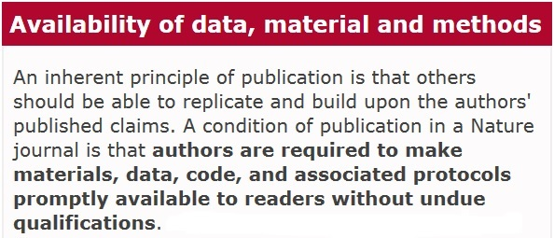
Journal data policies
Nature Publications:
http://www.nature.com/authors/policies/availability.html

Slide 7
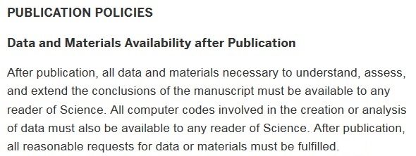
Journal data policies
Science:
http://www.sciencemag.org/authors/science-editorial-policies

Slide 8
Federal agency requirements
NSF Data Management Plan Requirements:
“Proposals must include a supplementary document of no more than two pages labeled "Data Management Plan”…describ[ing] how the proposal will conform to NSF policy on the dissemination and sharing of research results.”
http://www.nsf.gov/pubs/policydocs/pappguide/nsf15001/gpg_2.jsp#dmp

Slide 9
Federal agency requirements
OSTP Memorandum: Increasing Access to the Results of Federally Funded Scientific Research:
“…scientific data resulting from unclassified research supported wholly or in part by Federal funding should be stored and publicly accessible to search, retrieve, and analyze.”
https://www.whitehouse.gov/sites/default/files/microsites/ostp/ostp_public_access_memo_2013.pdf

Slide 10
Private foundations
Gordon and Betty Moore Foundation: Data Sharing Philosophy:
“All data used in or developed in whole or in part by foundation-funded projects…will be made widely available and freely shared as soon as possible.”
https://www.moore.org/docs/default-source/
Grantee-Resources/data-sharing-philosophy.pdf

Slide 11
Private foundations
Alfred P. Sloan Foundation: Grant Application Guidelines
“How will your data and code be shared, annotated, cited, and archived?”
http://www.sloan.org/fileadmin/media/files/application_documents/proposal_guidelines_research_trustee_grants.pdf

Slide 12
Thank you!
Rick Jaffe
Anna Sackmann
Elliott Smith
Jamie Wittenberg
Academic Innovation Studio, 18 July 2016

